Slide 1

McDonald’s Food Nutrition
Data Analysis
Manish Gupta

Slide 2

McDonald’s
McDonald's Corporation is an American-based multinational fast food chain, founded in 1940 in San Bernardino, California, United States.
McDonald's is the world's largest restaurant chain by revenue serving over 69 million customers daily in over 100 countries in more than 40,000 outlets as of 2021
McDonald's is best known for its hamburgers, cheeseburgers and french fries, although their menus include other items like chicken, fish, fruit, and salads. McDonald's has been subject to criticism over the health effects of its products.

Slide 3
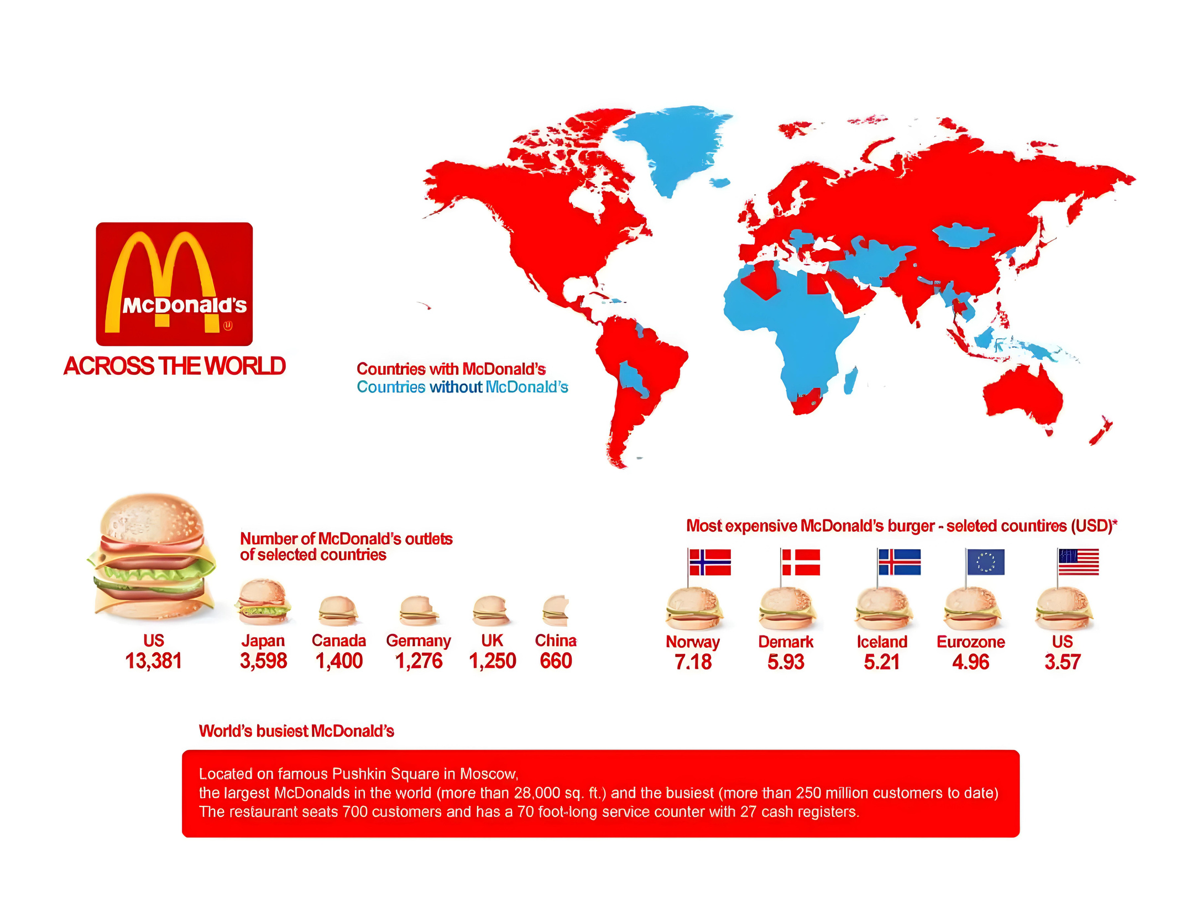

Slide 4

Problem statement :
Analysis the given dataset and make different predictions and draw meaningful conclusion so that it should be benificial for both company as well as customer.
Also state what can we learn from different predictions.
Prepare the report which can show how the customer could plan their meal.

Slide 5
Business benefits of the analysis
By analyzing nutrition value of the food items by the MacDonald’s, it will be easier to the customer to plan their meal according to their requirement.
This analysis report can attract to the customer who is very health conscious and believe in the past criticism of the MacDonald about unhealthy food items.
Customer who is on special diet due to different health problems such as overweight, vitamins deficiency anemia etc can also enjoy the MacDonald’s food items by checking nutrition values of the food items.
This report may lead to company revenue growth. Also company reputation and legacy may save from further criticism over the food.

Slide 6
About Dataset :
Given dataset contains different food items with their fat, calories, cholesterol, carbohydrates, sodium, dietary fibre, sugar, proteins, vitamins contents.
McDonalds provides 9 different food category which contains 260 different food items.
Table in the given dataset contains 260 rows and 24 columns. It means that there is no duplicate values in the given dataset.

Slide 7
Inspiration
How many calories does the average McDonald's value meal contain?
How much do beverages, like soda or coffee, contribute to the overall caloric intake?
Does ordered grilled chicken instead of crispy increase a sandwich's nutritional value?
What about ordering egg whites instead of whole eggs?
What is the least number of items could you order from the menu to meet one day's nutritional requirements?

Slide 8
Questions
1.What is the average nutrition values per category ?
2.Which food items contains maximum amount of protein and less amount of fat ?
3.Which food items contribute to high sodium intake ?
4.Which category contribute to maximum % of Cholesterol in a diet (% daily value) ?
5.Which 4 food items contain the most amount of Saturated Fat?
6.Which food category and which food item contains maximum vitamins content ?
7.Among chicken/fish and beef/pork, which food category is best for maximum protein intake ? why ?
8.Among breakfast and salad which food category is good for daily nutrition fulfillment ?
9.Adding beverage or tea to the meal, will it make significance difference to nutrition value ?

Slide 9
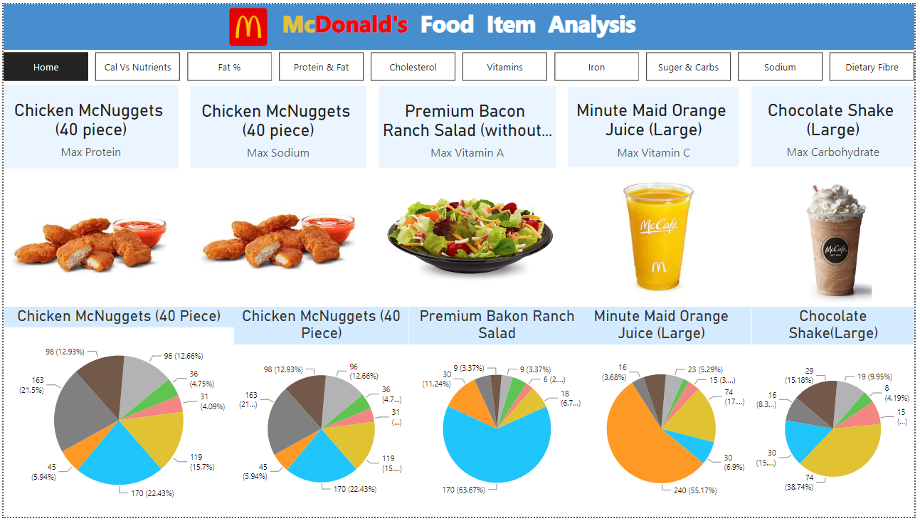

Slide 10
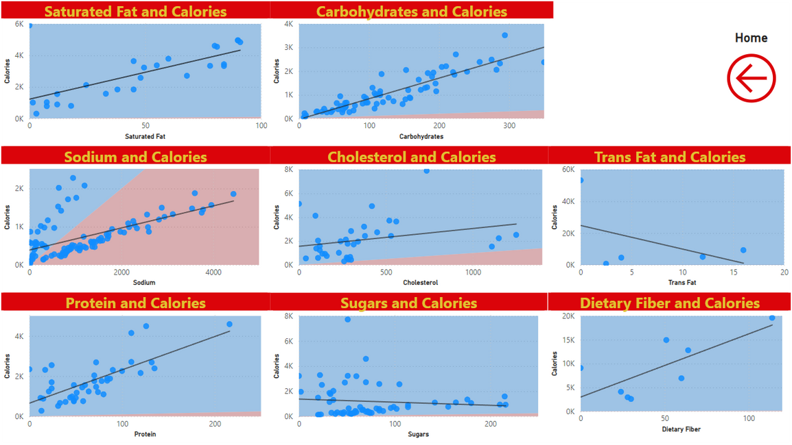
Cal Vs Nutrients

Slide 11
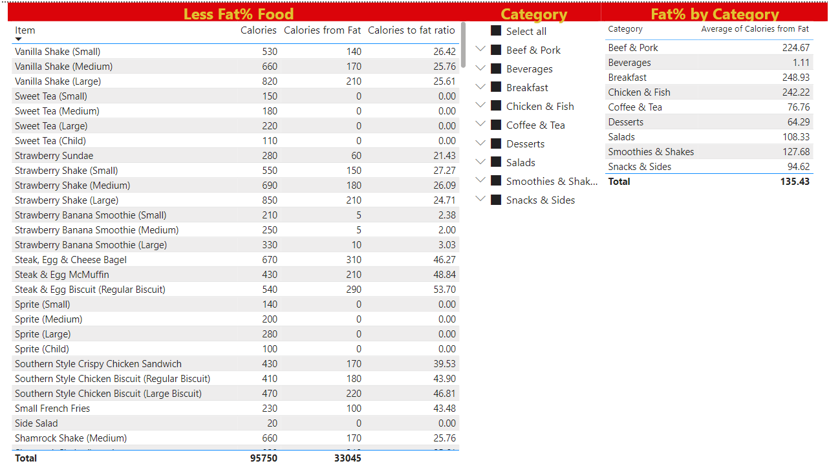
Fat %

Slide 12
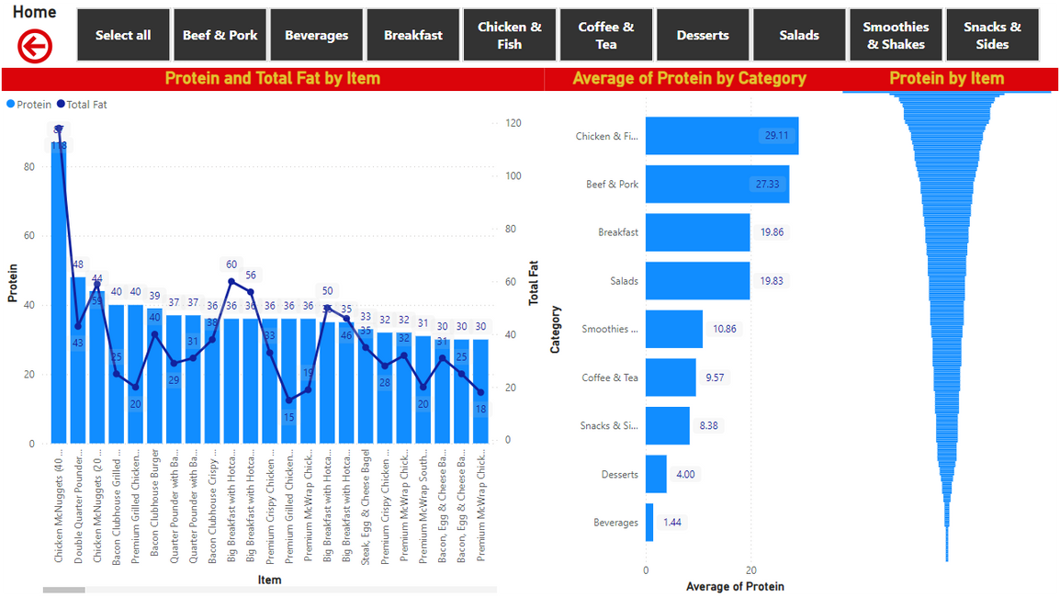
Protein & Fat

Slide 13
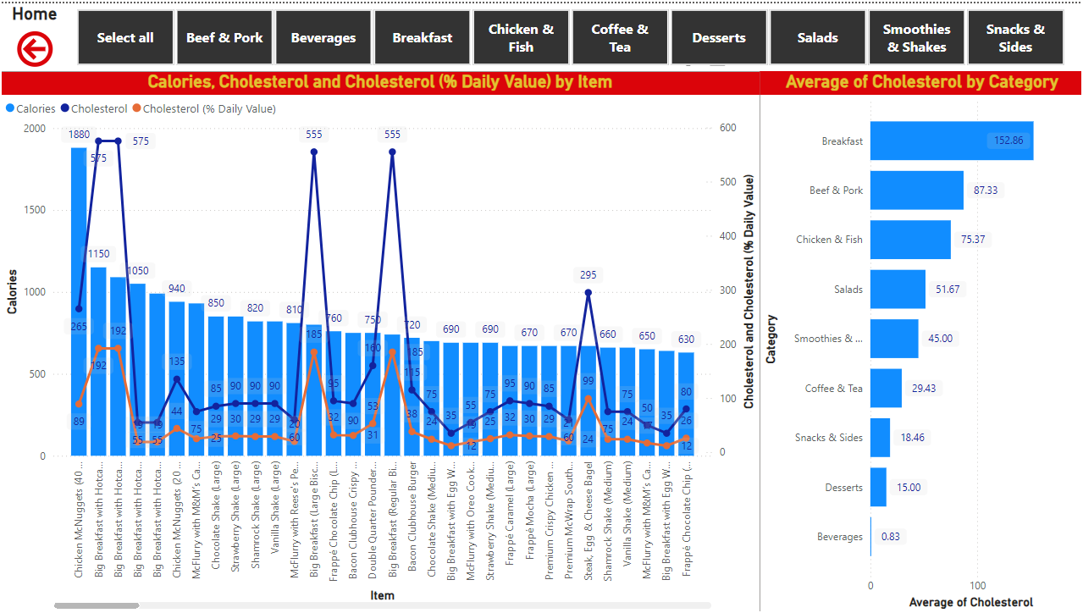
Cholesterol

Slide 14
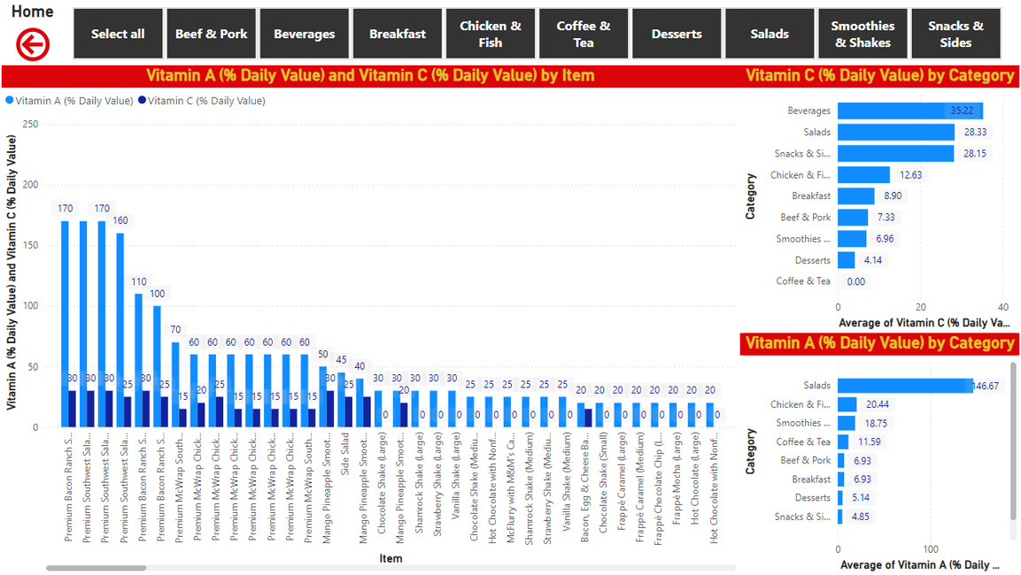
Vitamins

Slide 15
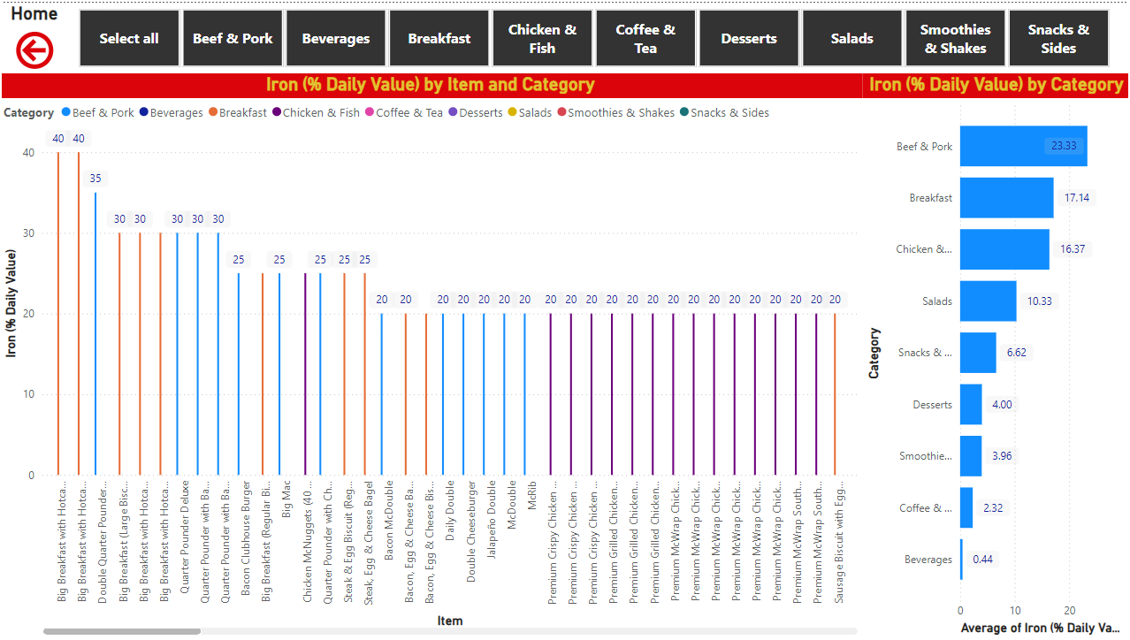
Irons

Slide 16
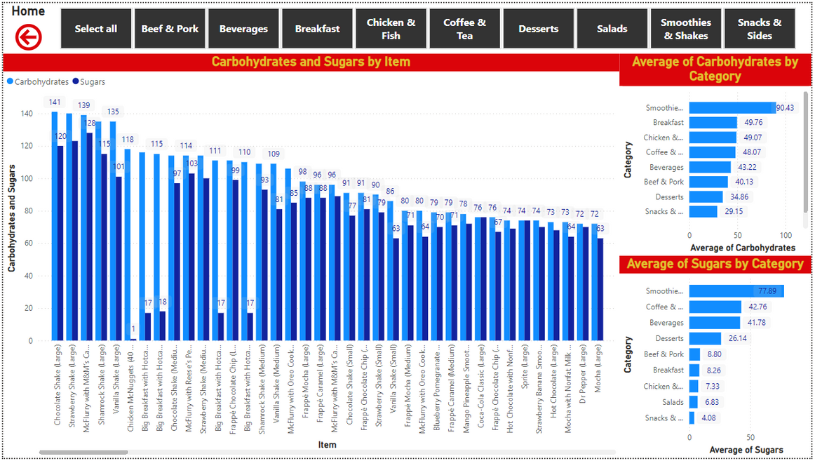
Suger & Carbs

Slide 17
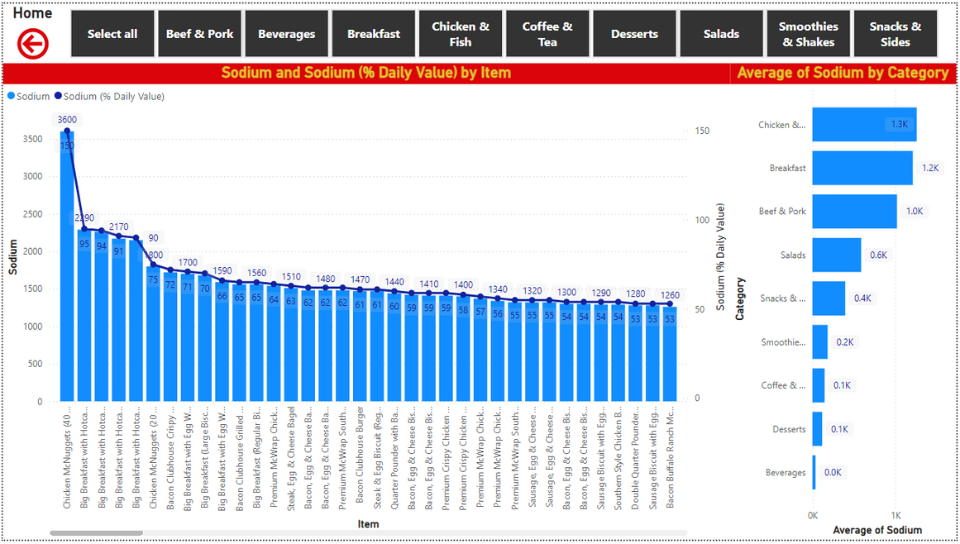
Sodium

Slide 18
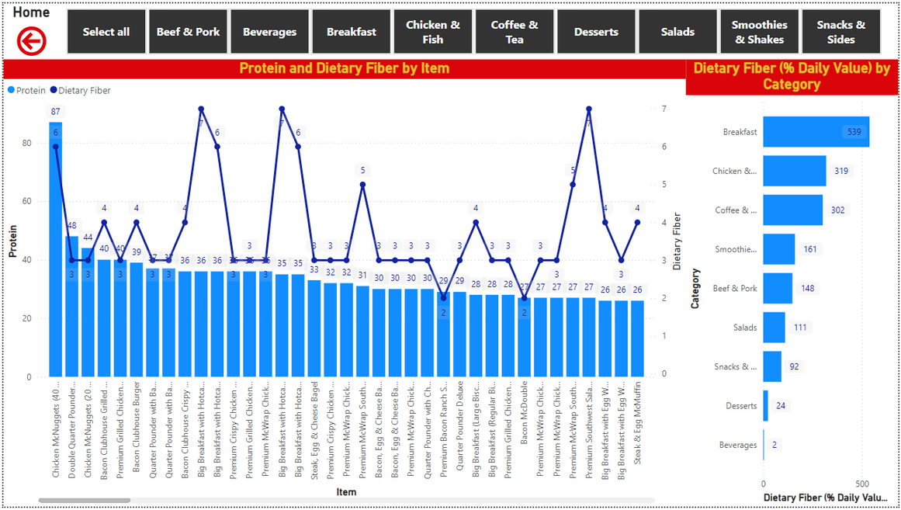
Dietary Fibre

Slide 19

Thank You
Manish Gupta

